Slide 2
Azure Static Web & GitHub
Subtitle or speaker name
MM Salman Faris (Microsoft Learn Student Ambassador)

Slide 3
Event Agenda
Introduction
Git & GitHub
Azure
Deployment
Q&A

Slide 4

Notes:
Please adjust this slide to the end of your presentation
https://go.microsoft.com/fwlink/?linkid=2271366

Slide 5
Git and GitHub

Slide 6

What is Azure?
Microsoft Azure is a cloud computing platform created by Microsoft.

Slide 7
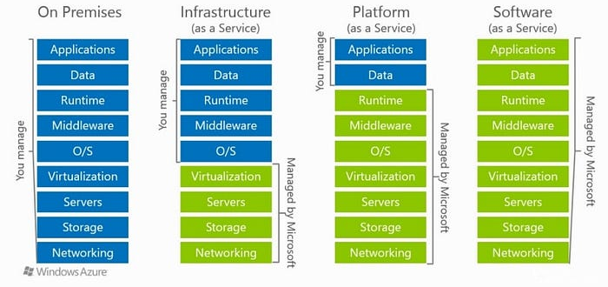
Cloud Models

Slide 8
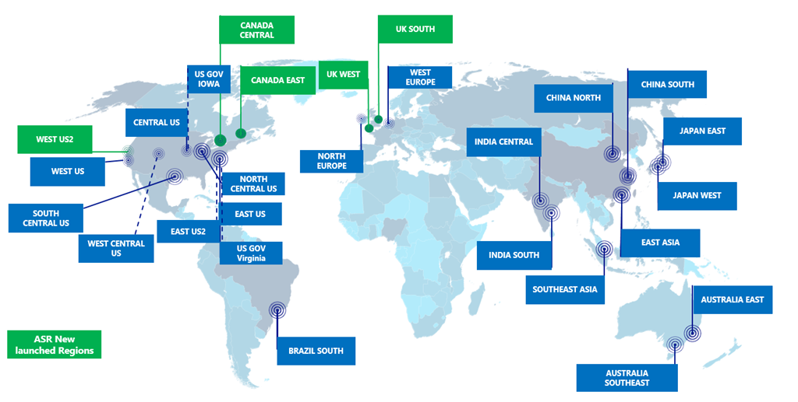
Datacenter & Regions

Slide 9
Azure Main Services

Slide 10
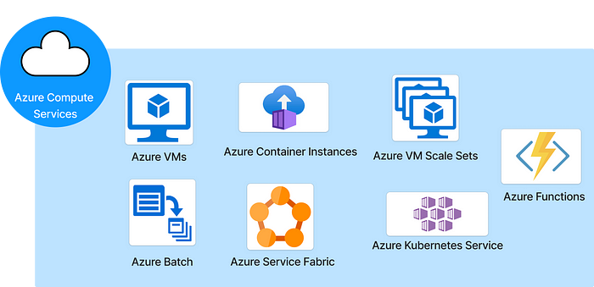

Slide 11
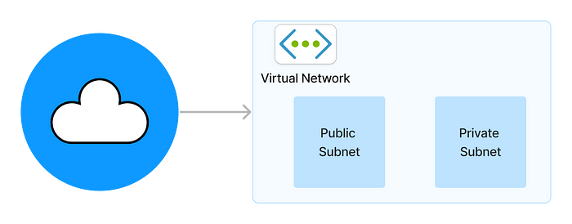

Slide 12
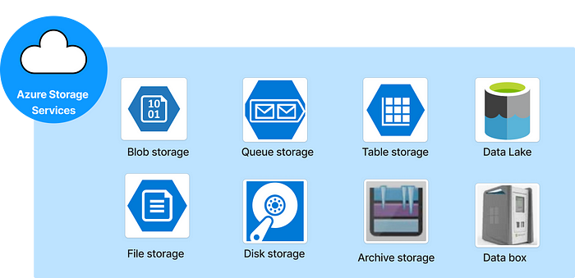

Slide 13
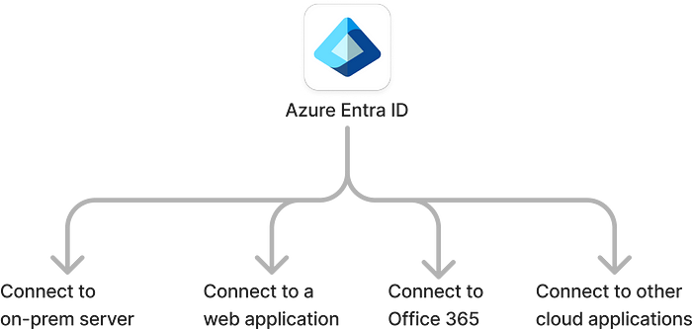

Slide 14
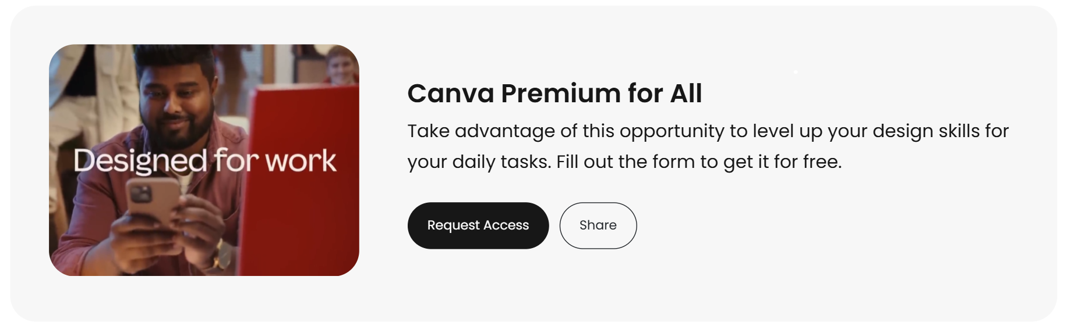

Slide 15
Static Web App Deployment

Slide 16


Slide 17
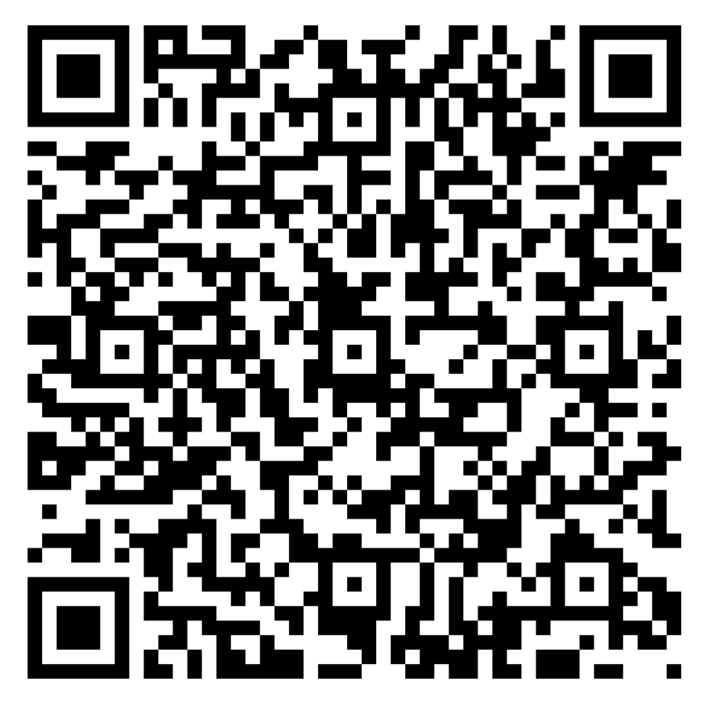
Session Feedback

Slide 19
Event name or presentation title
Subtitle or speaker name

Slide 20
Event name or presentation title
Subtitle or speaker name

Slide 21
Event name or presentation title
Subtitle or speaker name

Slide 22
Text layout (without bullet points)
Main topic: Segoe UI Semilight, size 28pt
Segoe UI, size 20pt for second level
Segoe UI, size 16pt for third level

Slide 23
Text layout with bulleted text
Main topic: Segoe UI Semilight, size 28pt
Segoe UI, size 20pt for second level
Segoe UI, size 16pt for third level

Slide 24
Text layout with bulleted text
Main topic: Segoe UI Semilight, size 28pt
Segoe UI, size 20pt for second level
Segoe UI, size 16pt for third level

Slide 25
Example with longer headline text wrapping to a second line
When the headline text is 2 lines, move this text block down to align to the lower blue guide
If you don’t see guidelines, click on the View menu, and then check the box in front of “Guides”
Use a “soft return” Shift + Enter to wrap text without adding extra line spacing

Slide 26
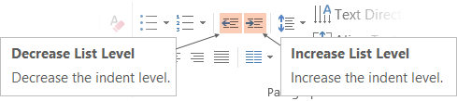
Adjusting list levels
Main topic: Segoe UI Semilight, size 28pt
Segoe UI, size 20pt for second level
Segoe UI, size 16pt for third level
Use the “Decrease List Level” and “Increase List Level” tools on the Home menu to change text levels.
Try this:
Place your cursor in the line of text that says “Segoe UI, size 20pt for second level”
Next click the Home tab, and then on the “Decrease List level” tool. Notice how the line moves up one level.
Now try placing your cursor in one of the top “Main topic…” line of text. Click the “Increase List Level” tool and see how the text is pushed in one level.
Use these 2 tools to adjust your text levels as you work

Slide 27
Bullet points layout with subtitle Set the subtitle to 20pt in the same text block, with character spacing Normal
Move the text block down vertically to align to lower guide
If you don’t see guidelines, click on the View menu, and then check the box in front of “Guides”
Hyperlink style: www.microsoft.com

Slide 28
Slide palette info
The PowerPoint palette for this template has been built for you and is shown below.
Avoid using too many colors in your presentation.
PowerPoint Theme Accent colors
Accent 1
Accent 2
Accent 3
Accent 4
Accent 5
Accent 6
Use Accent 1 and Accent 2 as the main accent colors.
Use Accent 3 and Accent 4 when additional colors are needed.
Use Accents 5-6 sparingly

Slide 29
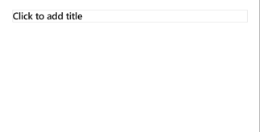
Creating accessible content
Take the following steps to create accessible content that everyone can consume effectively.
Contrast
Use high contrast colors for maximum readability
The recommended contrast ratio is at least 4.5:1
Shape and color
Use different shapes with a legend to indicate statuses to accommodate for color blindness
Example:
Alt text
Alt text helps people with screen readers understand the content of slides
You can create alternative text for shapes, pictures, charts, tables, SmartArt graphics, or other objects
Here’s how:
Right click the image or shape
Select Edit Alt Text
Enter a Title and Description of your image or object
Slide layouts
Using a built-in slide layout that matches your content ensures a hierarchical reading order of text blocks
Example:
If a new slide will have a title, rather than starting with a blank layout and adding a text block for the title, choose one of the built-in layouts with a title placeholder
Reading order
Screen readers describe content on the screen in the order it was created
To ensure your content is read back in the order you prefer, arrange your objects in the Selection Pane appropriately. Objects on the bottom of the selection pane are read first
Here’s how:
Click the Home tab
In the Drawing group, select the Arrange drop-down menu
Click Selection Pane…
Text
Text
Text
Subject 1
Subject 2
Subject 3
Color Contrast Analyzer
Download this tool to determine the legibility of text and the contrast of visual elements
Download
C1
C2
C3
Additional tips
Be sure to run the Accessibility Checker! Go to File click the Check for Issues drop down menu click Check Accessibility
Videos need to be accessible: If your presentation includes a video, ensure it is captioned and audio described (if appropriate)
Visit the Office Accessibility Center to learn more about accessibility in PowerPoint

Slide 30
Demo
Speaker name

Slide 31
Video

Slide 32
Section title

Slide 33
Software code slide
This slide layout uses Consolas, a monotype font which is ideal for showing software code.

Slide 34
Notes (hidden)
Some speakers at Microsoft like to use this slide for hidden “notes slides”.
Delete it if you don’t want to use it.
NEXT: <next slide title>

